Slide 1
League of Legends: How Does Character Choice Affect Win Rate Across Ranks?
Oliver Ng
ECO590

Slide 2
Motivation
League of Legends is a massive multiplayer game with ~117-135 million monthly players.
League has 172 characters and 10 ranks.
Competitive games inevitably develop a metagame.

Slide 3
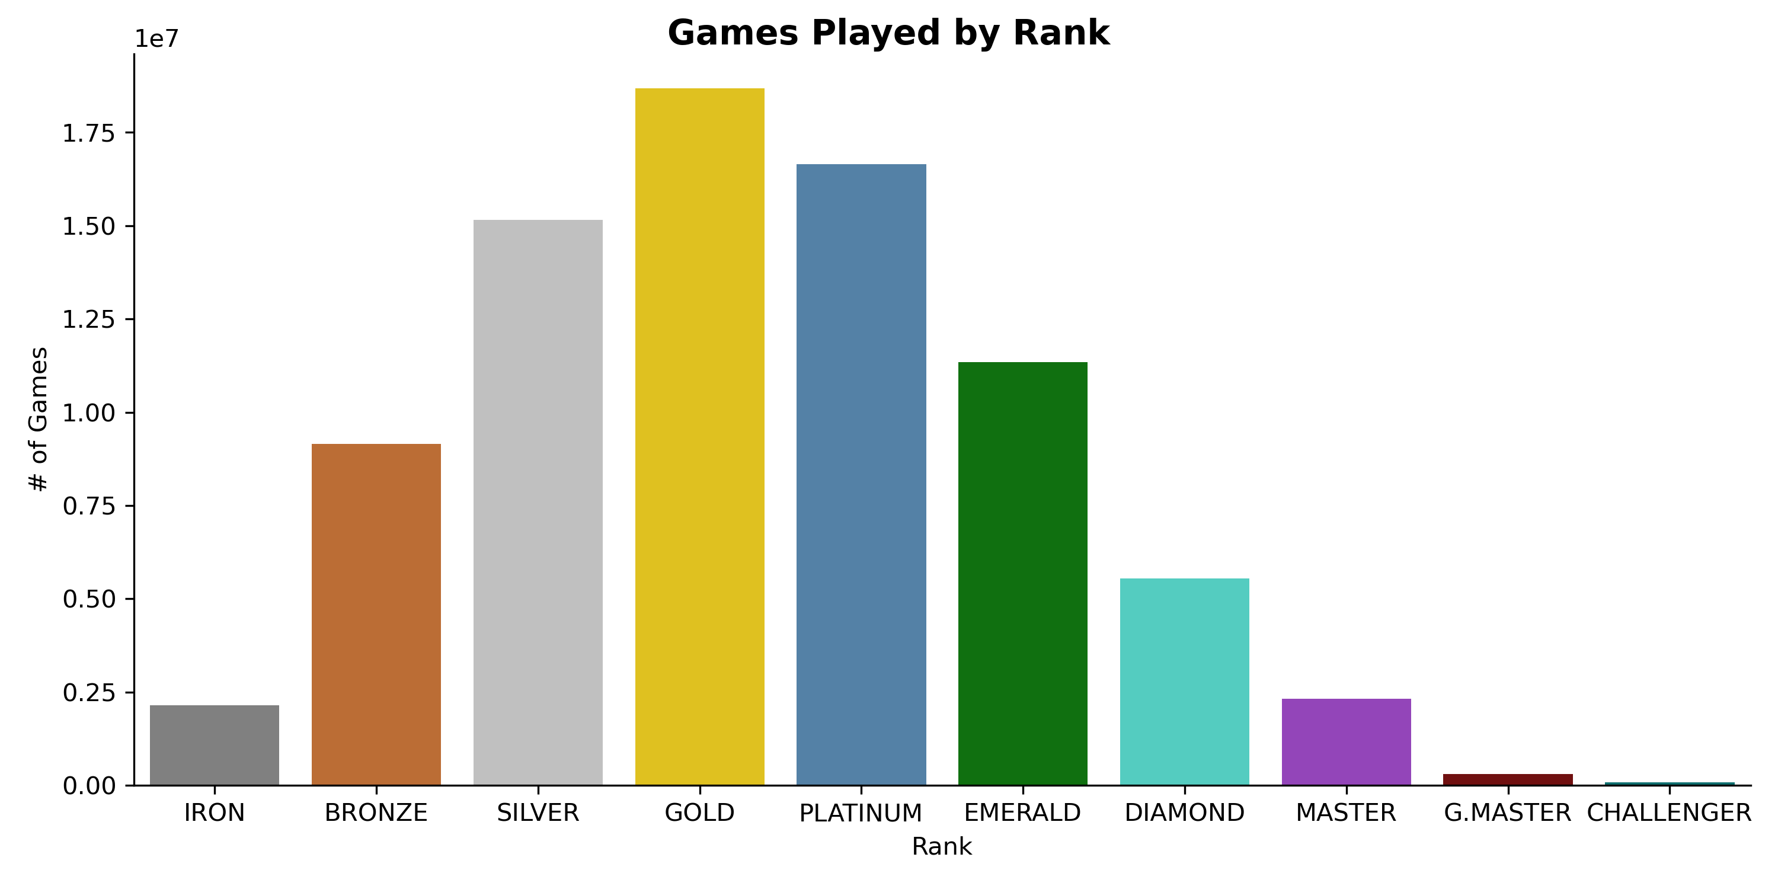

Slide 4
Research Question(s)
How much of an effect does meta character choice have on win rate?
How much does this effect differ across each of League's rank?

Slide 5
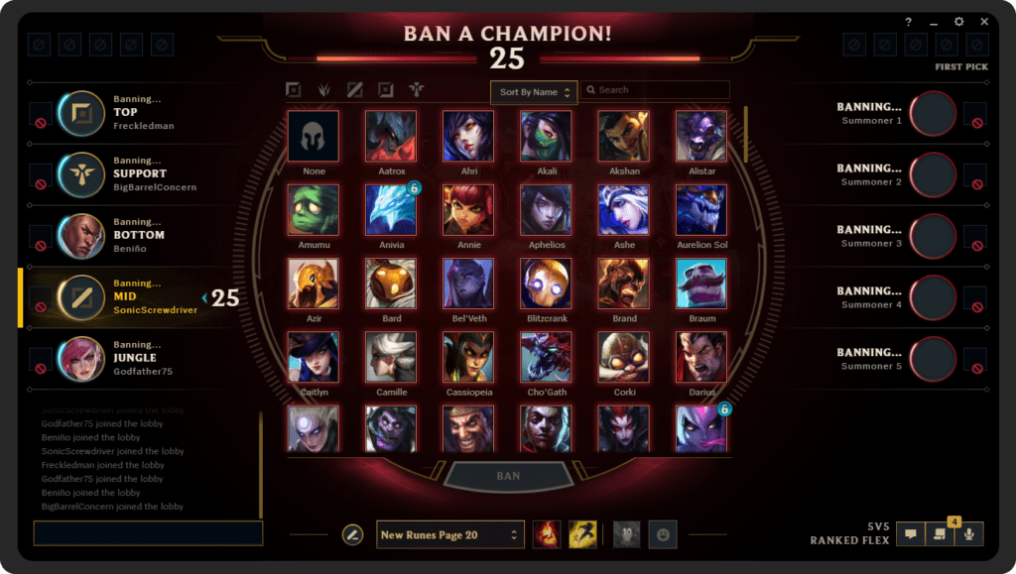
Context

Slide 6
Key Variables
Dependent Variable: Character Win Rate
Independent Variable: “Pick Ban Influence” (PBI)
Controls: Rank, # of Games, Lane

Slide 7
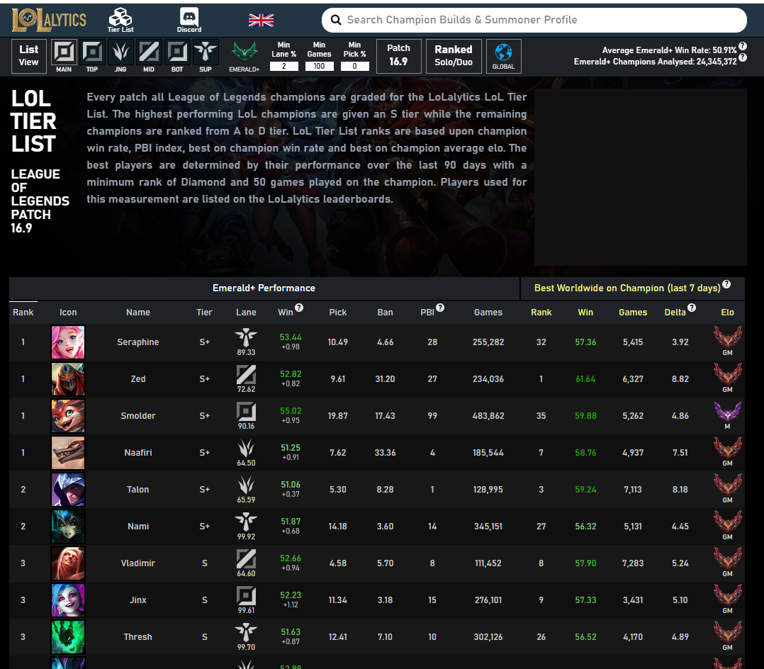

Slide 8










Slide 9
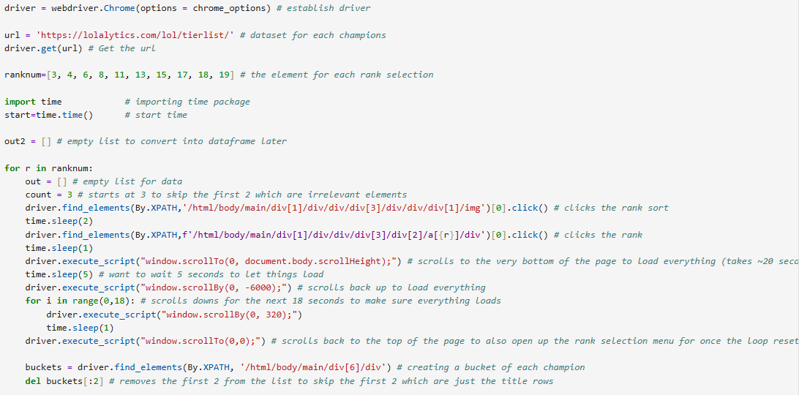
Webscraping with Selenium

Slide 10
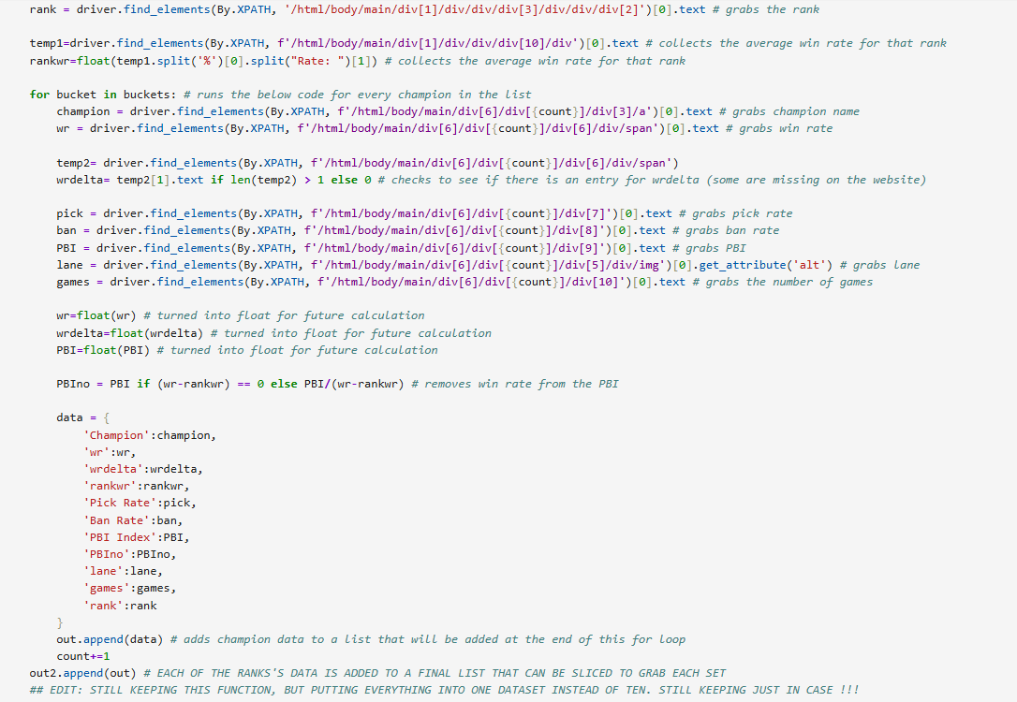

Slide 11
New Variables
PBI includes win rate in its calculation.
Difference in win rate.
Captured negative preference.

Slide 12
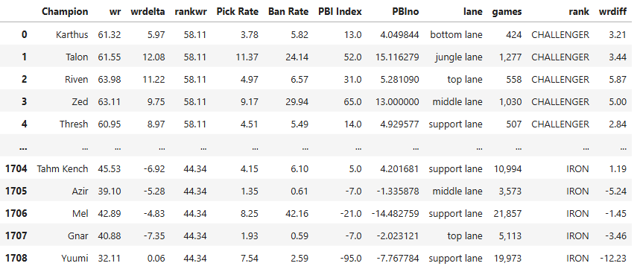

Slide 13
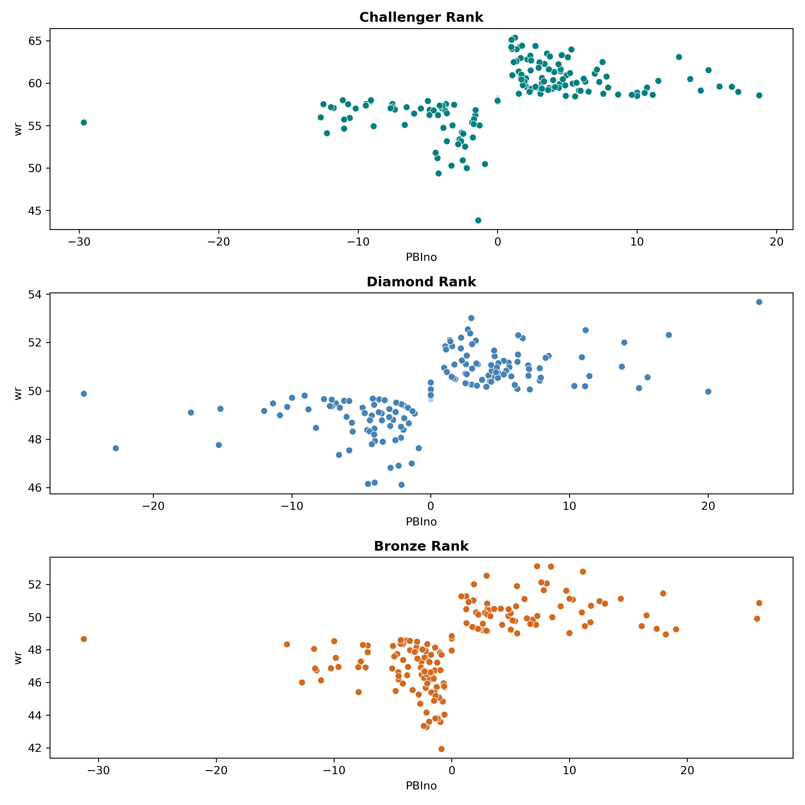
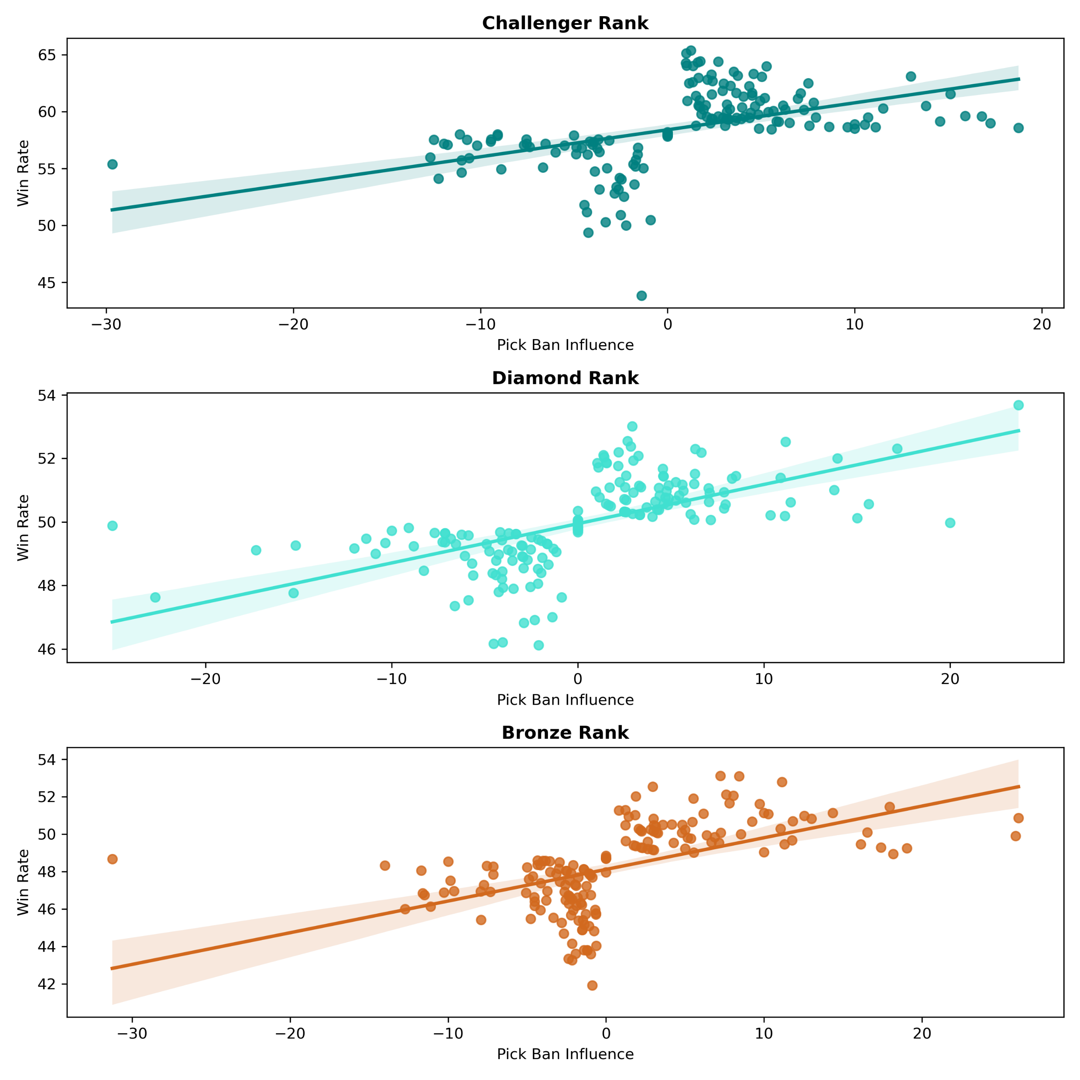
Graphs
Across three rank thresholds.
There is a positive correlation here between win rate and Pick Ban Influence.

Slide 14
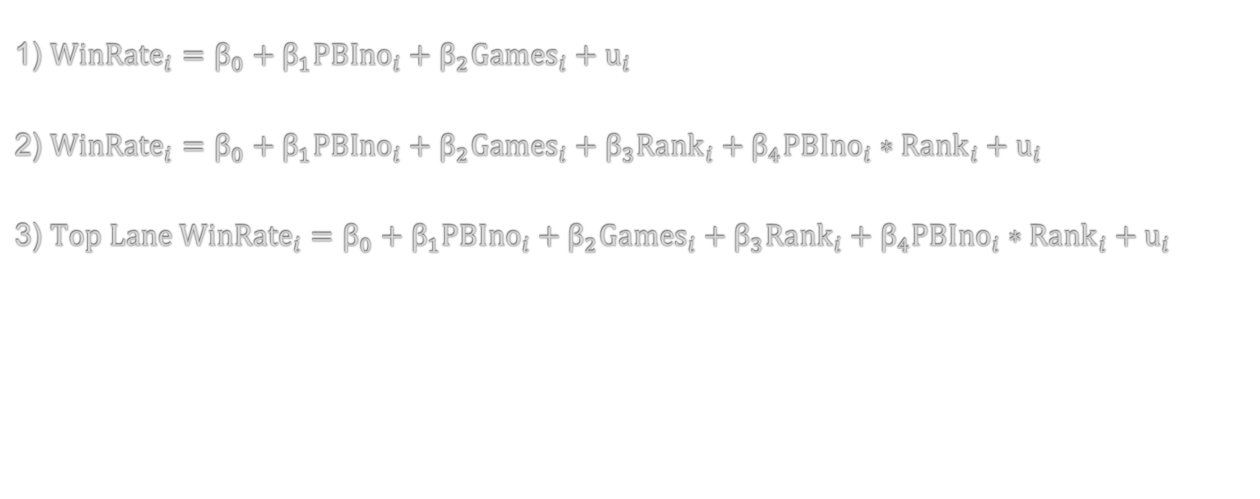
Models
1) ${WinRate}_{i}=β_{0}+β_{1}{PBIno}_{i}+β_{2}{Games}_{i}+u_{i}$
2) ${WinRate}_{i}=β_{0}+β_{1}{PBIno}_{i}+β_{2}{Games}_{i}+β_{3}{Rank}_{i}+β_{4}{PBIno}_{i}∗{Rank}_{i}+u_{i}$
3) ${Top Lane WinRate}_{i}=β_{0}+β_{1}{PBIno}_{i}+β_{2}{Games}_{i}+β_{3}{Rank}_{i}+β_{4}{PBIno}_{i}∗{Rank}_{i}+u_{i}$

Slide 15
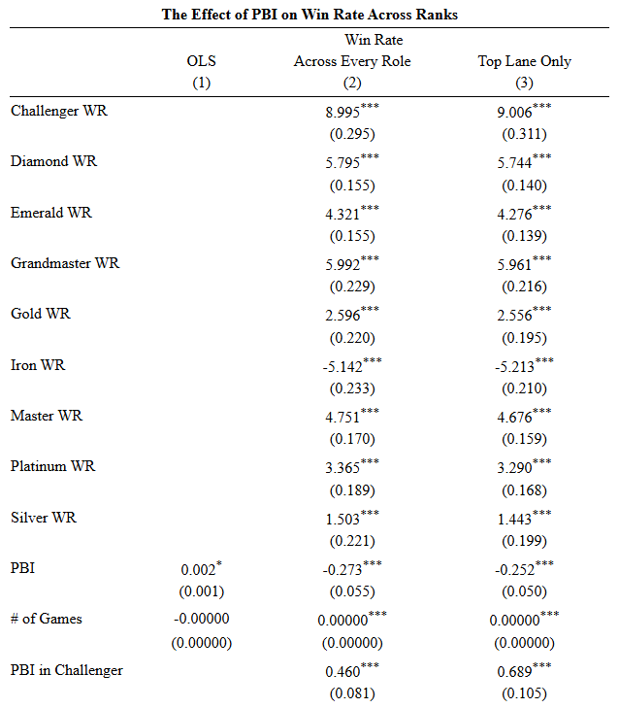
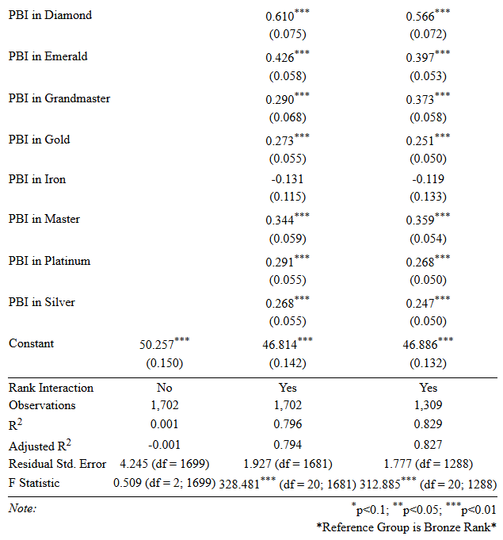

Slide 16






Slide 17






Slide 18
Conclusions & Future Work
Low ranks do not care about meta character choices
Apex ranks do care, but not as much as Diamond players.
Data can be cleaned up more.
Would like to implement different models other than OLS.

Slide 19
Thank you!

Slide 20

Thank you!

